Slide 1

HOTEL BOOKING ANALYSIS
ZEESHAN MOMIN
Week 1 Portfolio Project January 2025

Slide 2
PROJECT OVERVIEW
- Dataset: 119,000+ hotel bookings
- Hotels: City Hotels vs Resort Hotels
- Tools: Excel, Pivot Tables, Charts, Dashboards
- Objective: Revenue & operational insights

Slide 3
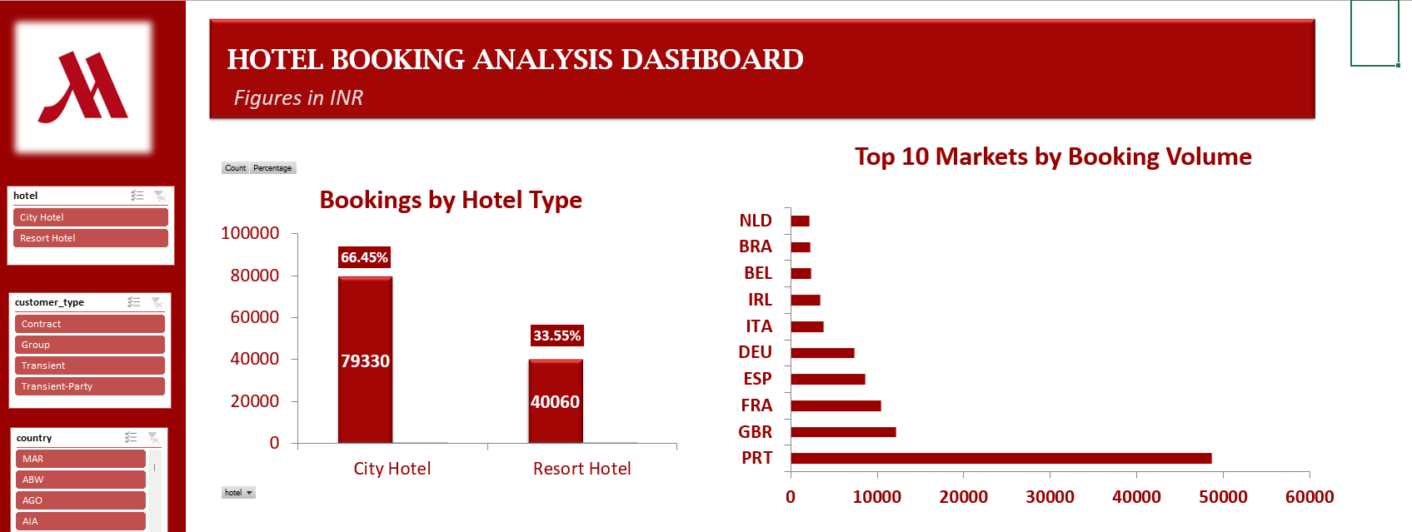
KEY FINDINGS
BOOKINGS DISTRIBUTION
- City Hotels: 66.45% of total bookings
- Resort Hotels: 33.55% of total bookings
TOP MARKETS
- Top 3 countries: Portugal, Great Britain, France
- These markets represent: 71% of total bookings

Slide 4
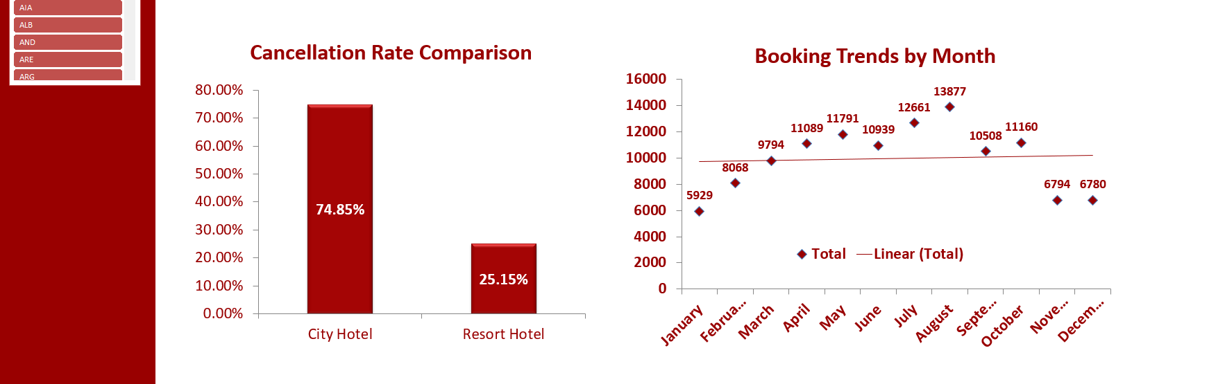
KEY FINDINGS
CANCELLATION RATES
- City Hotels: 75% cancellation rate
- Resort Hotels: 25% cancellation rate
- Finding: City Hotels have higher cancellation rates as compared to resort hotels
SEASONAL PATTERNS
- Peak months: July & August
- Low season: December & Jan

Slide 5
REVENUE ANALYSIS
REVENUE INSIGHTS [Average Daily Rate (ADR)]:
* City Hotels: ₹105.30
* Resort Hotels: ₹94.95
- Finding: City Hotels have higher Daily rate as compared to resort hotels

Slide 6
RECOMMENDATIONS
1. Based on cancellations - Can replace full refund within 24 hours cancellation to 48 hours to reduce cancellations.
2. Based on ADR - Can adopt bucket pricing approach to cross-sell other optional services like Spa, Sauna, Parlour, Bar coupons to increase average revenue per booking.
3. Based on markets - Need to identify the reason for the concentration of revenue and focus on strengths and weakness to expand and increase efficiency.
4. Based on seasonality - Must focus on different market segments to fill the gap in low season. For example, targeting corporate travellers in low season period when events and exhibitions happen instead of tourists.

Slide 7
Thank you for watching

